Slide 1
PITP
JavaScript Advance

Slide 2
What is AJAX?
AJAX = Asynchronous JavaScript And XML.
AJAX is not a programming language.
AJAX just uses a combination of:
A browser built-in XMLHttpRequest object (to request data from a web server)
JavaScript and HTML DOM (to display or use the data)

Slide 3
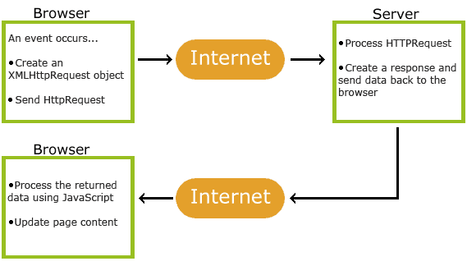
AJAX Working

Slide 4
AJAX
. An event occurs in a web page (the page is loaded, a button is clicked)
2. An XMLHttpRequest object is created by JavaScript
3. The XMLHttpRequest object sends a request to a web server
4. The server processes the request
5. The server sends a response back to the web page
6. The response is read by JavaScript
7. Proper action (like page update) is performed by JavaScript

